Slide 1
Graphs
Course Code: 00090
Course Title: Discrete Mathematics
Dept. of Computer Science
Faculty of Science and Technology
Lecturer No: | 15 | Week No: | 9 | Semester:
Lecturer: | Name & email

Slide 2
Lecture Outline
Graphs and Graph Models (8.1)l
Multigraph
Pseudograph
Simple directed graph
Directed Multigraph
Mixed graph
Graph Terminology and Special Types of Graphs (8.2 )
Basic terminology
Adjacent vertices
Degree of a vertex
In-degree of a vertex
Out-degree of a vertex
Isolated vertex
Pendant vertex
The Handshaking Theorem
Some Special Simple Graphs
Bipartite Graphs

Slide 3
Objectives and Outcomes
Objectives: To understand basic terminologies of graph with examples, Handshaking theorem for undirected and directed graphs, some special types of graphs, bipartite graph and complete bipartite graph.
Outcomes: The students are expected to be able explain graph terminologies, be able to find out degree of vertices and prove Handshaking theorem, be able to draw Complete graph, Cycle, Wheel, n-cube, be able to determine whether a graph is bipartite using graph coloring.

Slide 4
Directed Graph
Definition 2: A directed graph(or digraph) (V,E) consists of a nonempty set of vertices V and a set of directed edges E.
Each directed edge is associated with an ordered pair of vertices.
The directed edge associated with the ordered pair (u,v) is said to start at u and end at v.

Slide 5
Directed Graph
The edges are ordered pairs of (not necessarily distinct) vertices.
Detroit
New York
Chicago
San Francisco
Denver
Washington
Los Angeles
Some telephone lines in the network may operate in only one direction.
Those that operate in two directions are represented by pairs of edges in opposite directions.

Slide 6
Graph Terminology : Different Types of Graphs
Simple Graph: An undirected graph with no multiple edges or loops is called a simple graph.
Multigraph: An undirected graph that may contain multiple edges connecting the same vertices but no loops.
Pseudograph: An undirected graph that may contain multiple edges and loops is called a pseudograh. p

Slide 7
Simple Graph Example
Detroit
New York
San Francisco
Chicago
Denver
Washington
Los Angeles
This simple graph represents a network.
The network is made up of computers and telephone links between computers.
In a simple graph each edge is connected with a pair of vertices and no two edges are connected with same pair of vertices.

Slide 8
Multigraph
A multigraph can have multiple edges (two or more edges connecting the same pair of vertices).
Detroit
New York
San Francisco
Chicago
Denver
Washington
Los Angeles
There can be multiple telephone lines between two computers in the network.

Slide 9
Pseudograph
A Pseudograph can have multiple edges and loops (an edge connecting a vertex to itself).
Detroit
San Francisco
Chicago
New York
Denver
Washington
Los Angeles
There can be telephone lines in the network from a computer to itself.

Slide 10
Graph Terminology : Different Types of Graphs
Simple Directed graph: When a directed graph has no loops and has no multiple directed edges, it is called a simple directed graph.
Directed multigraph: A graph with directed edges that may contain multiple directed edges is called a directed multigraph.
Mixed Graph: A graph with both directed and undirected edges is called a mixed graph. A mixed graph may contain loop(s).
Loop: An edge that connect a vertex to itself is called a loop.

Slide 11
Directed Multigraph
A directed multigraph is a directed graph with multiple edges between the same two distinct vertices.
m directed edges, associated with vertices (u, v), then (u, v) is an edge with multiplicity m.
Detroit
New York
Chicago
San Francisco
Denver
Washington
Los Angeles
There may be several one-way lines in the same direction from one computer to another in the network.

Slide 12
Graph Terminology : Different Types of Graphs
Table 1: Graph Terminology
Type | Edges | Multiple Edges Allowed? | Loops Allowed?
Simple graph | Undirected | No | No
Multigraph | Undirected | Yes | No
Pseudograph | Undirected | Yes | Yes
Simple directed graph | Directed | No | No
Directed Multigraph | Directed | Yes | Yes
Mixed graph | Directed and Undirected | Yes | Yes

Slide 13
Graph Terminology and Special Types of Graphs (8.2)
Basic terminology
Adjacent vertices
Degree of a vertex
In-degree of a vertex
Out-degree of a vertex
Isolated vertex
Pendant vertex
The Handshaking Theorem
Some Special Simple Graphs
Bipartite Graphs

Slide 14
Basic Terminology
Definition1: Two vertices u and v in an undirected graph G are called adjacent (or neighbors) in G if u and v are endpoints of an edge of G.
If e is associated with {u, v}, the edge e is called incident with the vertices u and v.
The edge e is also said to connect u and v.
The vertices u and v are called endpoints of an edge associated with {u, v}.

Slide 15
Basic Terminology
Definition 3: The degree of a vertex in an undirected graph is the number of edges incident with it, except that a loop at a vertex contributes twice to the degree of that vertex.
The degree of the vertex v is denoted by deg(v)
Isolated vertex: A vertex of degree zero is called isolated.
Pendant vertex: A vertex is pendant if and only if it has degree one.

Slide 16
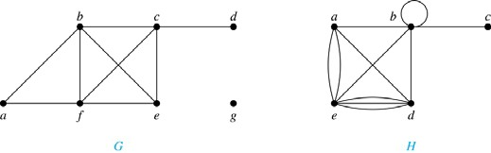
Example 1
Example 1 : What are the degrees of the vertices in the graphs G and H?
Solution:
G: deg(a) = 2, deg(b) = deg(c)= deg(f)=4, deg(d)=1, deg(e) = 3, and deg(g)= 0
H: deg(a) = 4, deg(b) = deg(e) = 6, deg(c) = 1, deg(d) = 5.

Slide 17
The Handshaking Theorem
Theorem 1 (The Handshaking Theorem):
Let G = (V,E) be an undirected graph with e edges. Then
2e =
deg(v)
Note: This applies even if multiple edges and loops are present

Slide 18
Example 2
Example 2: How many edges are there in a graph with 10 vertices each of degree six?
Solution: Because the sum of the degrees of the vertices is 6.10 = 60, it follows that 2e=60.
Therefore, e = 30

Slide 19
Theorem 2
Theorem 2: An undirected graph has an even number of vertices of odd degree.
Example: If a graph has 5 vertices, can each vertex have degree 3?
Solution: This is not possible by the Handshaking theorem, because the sum of the degrees of the vertices 3.5 = 15 is odd.

Slide 20
Initial vertex & Terminal Vertex
Definition 3: When (u, v) is an edge of the graph G with directed edges, u is said to be adjacent to v and v is said to be adjacent from u.
The vertex u is called the initial vertex of (u, v) and
v is called the terminal/end vertex of (u, v).
Note: The initial vertex and terminal vertex of a loop are the same.

Slide 21
In-degree & Out-degree of a vertex
Definition 4: In a graph with directed edges the
in-degree of a vertex v, denoted by deg–(v), is the number of edges with v as their terminal vertex.
The out-degree of v, denoted by deg⁺(v), is the number of edges with v as their initial vertex.
Note: A loop at a vertex contributes 1 to both the
in-degree and the out-degree of this vertex.

Slide 22
Example: In-degree & Out-degree of vertices of a graph
Question: What are in-degrees and out-degrees of all the vertices in the graph below?
2
1
3

Slide 23
Solution:
deg⁻(1) = 0
deg⁻(2) = 3
deg⁻(3) = 4
deg⁺(1) = 2
deg⁺(2) = 3
deg⁺(3) = 2
Practice Yourself: Example 4
2
1
3

Slide 24
Theorem 3
Theorem 3: Let G = ( V, E ) be a graph with directed edges. Then
➔ Handshaking Theorem for directed graph
deg–(v) =
deg⁺(v) = |E|

Slide 25
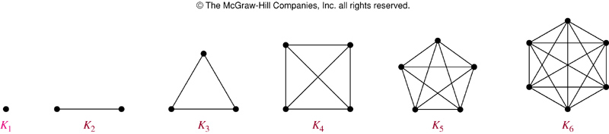
Some Special Simple Graphs: Complete Graph (K_{n} )
The complete graph on n vertices, denoted by K_{n}, is the simple graph that contains exactly one edge between each pair of distinct vertices.
The graph , for n = 1, 2, 3, 4, 5, 6 are displayed in the following figure:

Slide 26
Some Special Simple Graphs: Cycles (C_{n})
The Cycle C_{n}, n>=3, consists of n vertices v₁, v₂, ….v_{n} and edges {v_{1 ,} v₂ }, {v₂, v₃}, …. {v_{n-1}, v_{n} }, and {v_{n}, v₁ }
The cycles for C₃ , C₄ , C₅ , and C₆ are displayed in the following figure:
Cycles:
C₃
C₄
C₅
C₆

Slide 27
Some Special Simple Graphs: Wheels (W_{n})
We obtain the Wheel (W_{n}) when we add an additional vertex to the Cycle C_{n} , for n>=3, and connect this new vertex to each of the n vertices in C_{n} , by new edges.
The wheel W_{n} is just a cycle graph with an extra vertex in the middle
The Wheels W₃ , W₄ , W₅ are displayed in the figure below:

Slide 28
n-Cubes(Self study)
The n-dimensional hypercube, or n-cube denoted by Q_{n} is the graph that has vertices representing the 2^{n} bit strings of length n.
Two vertices are adjacent iff the bit string that they represent differ in exactly one bit position.
Example: Q₃ is shown here, where
Bit string of length 3 is represented
We have 2³ = 8 vertices
110
111
100
101
010
011
000
001

Slide 29
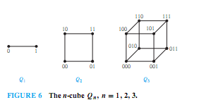
Some Special Simple Graphs: n-Cubes(Q_{n})
The n-dimensional hypercube, or n-cube, denoted by Q_{n}, is the graph that has vertices representing the 2^{n} bit strings of length n.
Two vertices are adjacent iff the bit strings that they represent differ in exactly one bit position.
The graphs Q₁, Q₂ , and Q₃are displayed in the following figure:

Slide 30
Bipartite graphs
Definition 5: A simple graph G is called bipartite if its vertex set V can be partitioned into two disjoint sets V₁ and V₂ such that every edge in the graph connects a vertex in V₁ and a vertex in V₂
Note: If each vertex of V₁ is connected to each vertex of V₂, then it is called complete bipartite graph and it is denoted by K_{m,n} where m is the number of vertices in V₁ and n is the number of vertices in V₂

Slide 31
Bipartite Graph
A simple graph is called bipartite if its vertex set V can be partitioned into two disjoint nonempty sets V₁ and V₂ such that every edge in the graph connects a vertex in V₁ and a vertex in V₂ (so that no edge in G connects either two vertices in V₁ or two vertices in V₂).
a b
c d
e
a
d
e
b
c

Slide 32
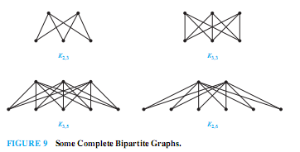
Examples of Complete Bipartite graphs

Slide 33
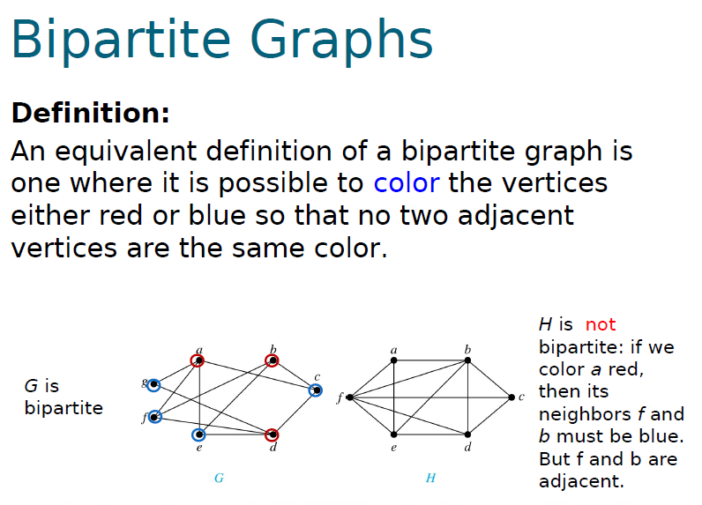
Example 11: Are the graphs G and H are Bipartite?

Slide 34
Practice @ Home
Relevant Odd-Numbered exercises from text book

Slide 35
Books
Rosen, K. H., & Krithivasan, K. (2012). Discrete mathematics and its applications: with combinatorics and graph theory. Tata McGraw-Hill Education. (7th Edition)
Liu, C. L. (1986). Elements of discrete mathematics. Tata McGraw-Hill Education.

Slide 36
References
Discrete Mathematics, Richard Johnsonbaugh, Pearson education, Inc.
Discrete Mathematical Structures, Bernard Kolman, Robert C. Busby, Sharon Ross, Prentice-Hall, Inc.
SCHAUM’S outlines Discrete Mathematics(2nd edition), by Seymour Lipschutz, Marc Lipson
Deo, N. (2017). Graph theory with applications to engineering and computer science. Courier Dover Publications.
Radford University Lecture: https://www.radford.edu/~nokie/classes/360/graphs-terms.html

